Slide 1
Setup
Download the repo at https://tinyurl.com/ai-sg-ws
Download latest Python at https://www.python.org/downloads/
In terminal:
cd ai-sg-workshop
pip3 install --upgrade pip
pip3 install -r requirements.txt
jupyter notebook

Slide 2
AI + Social Good
Fall 2017 Workshop

Slide 3
Recent Advances in AI
Deep learning has become feasible due to faster compute power and larger datasets
Neural networks very simply model complex data and problems
Very deep networks achieve human-level (or better) accuracy on many tasks

Slide 4
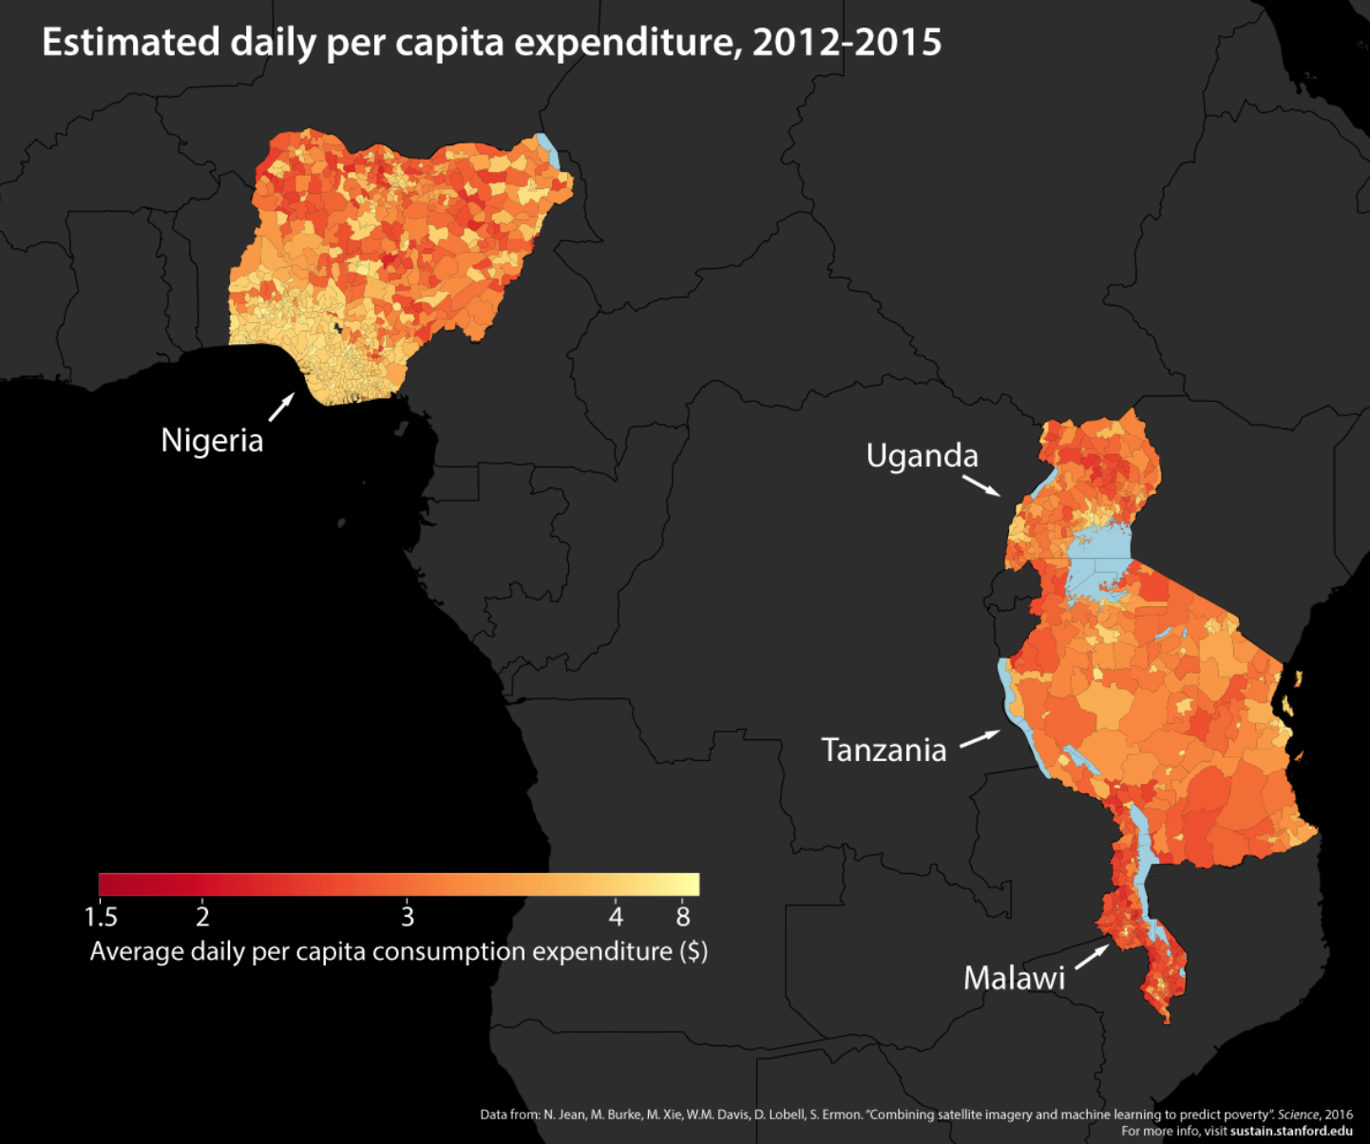
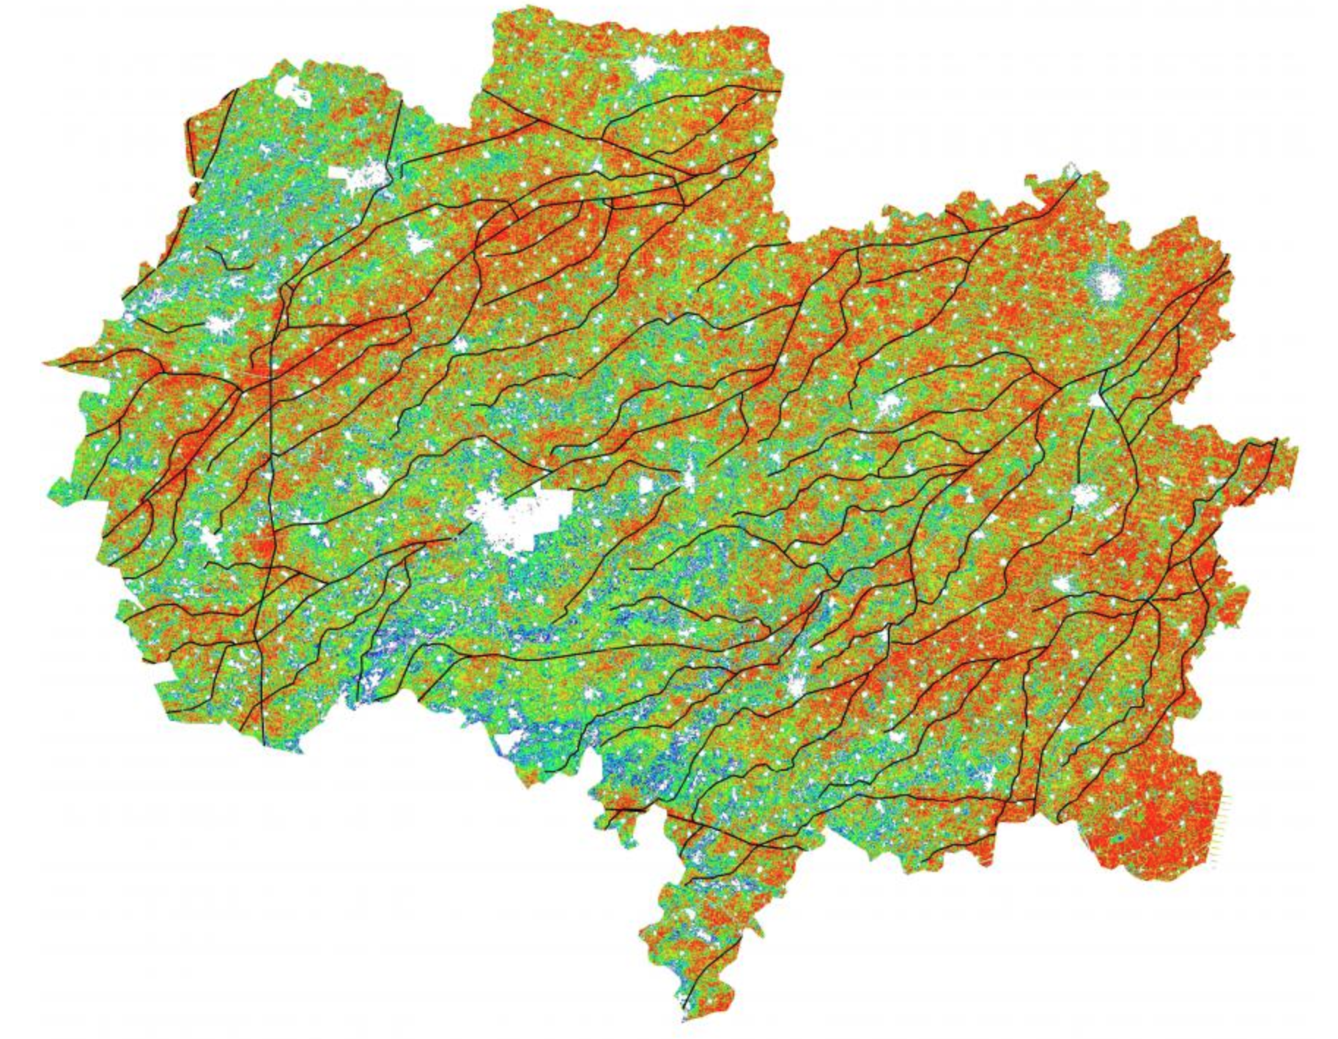
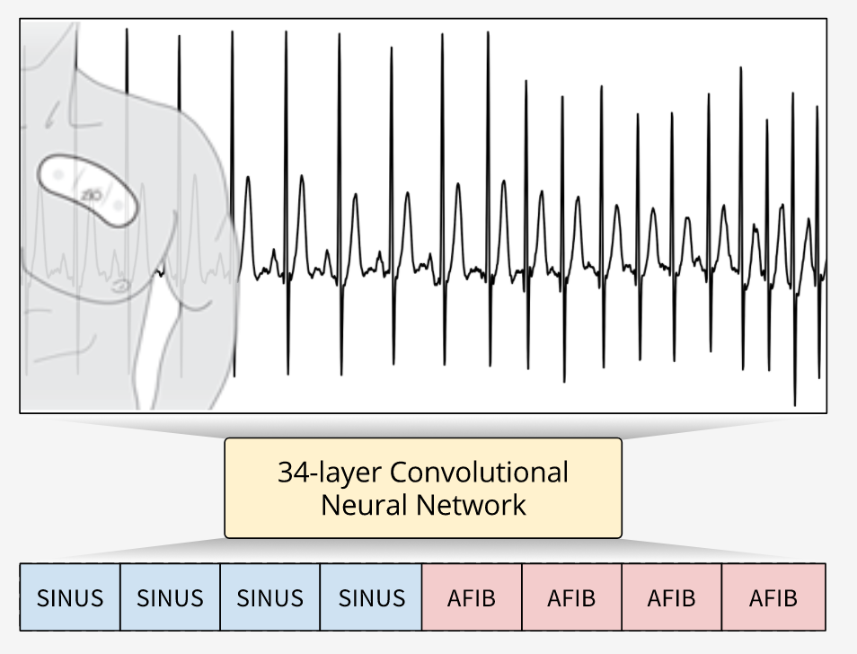
Social Good Applications
Detecting Arrhythmia (Rajpurkar, Hannun et. al)
Predicting Poverty (Jean et. al)
Predicting Crop Yield (You et. al)

Slide 5

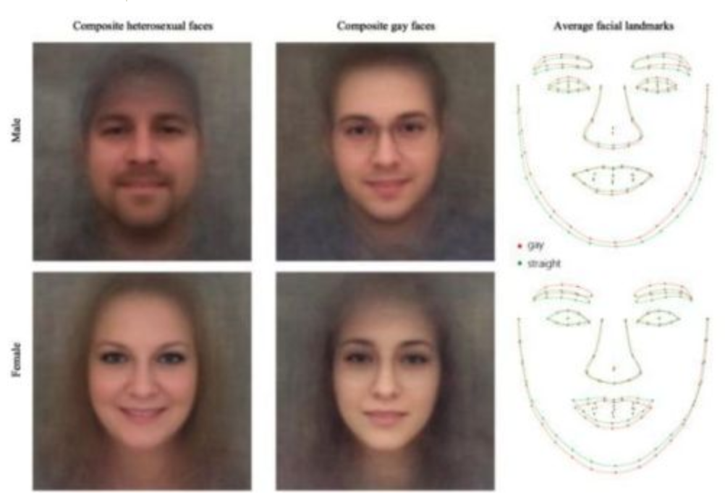
Potentially Harmful Applications
Labelling Pictures (Google Photos)
Predicting Sexuality (Wang et. al)

Slide 6
Problems in AI
Bias in dataset—not enough diversity
Automation could cause further wealth disparity
Engineers pushing cutting-edge, but not socially-relevant bottom line

Slide 7
Linear Algebra/NumPy Review

Slide 8
Matrix Multiplication

Slide 9
Matrix Multiplication Review
u v
w x
y z
a b c
d e f

Slide 10
u v
w x
y z
a b c
d e f
au + bw + cy
=

Slide 11
u v
w x
y z
a b c
d e f
au + bw + cy av + bx + cz
=

Slide 12
u v
w x
y z
a b c
d e f
au + bw + cy av + bx + cz
du + ew + fy
=

Slide 13
u v
w x
y z
a b c
d e f
au + bw + cy av + bx + cz
du + ew + fy dv + ex + fz
=

Slide 14
u v
w x
y z
a b c
d e f
au + bw + cy av + bx + cz
du + ew + fy dv + ex + fz
=

Slide 15
AB = C
M x N N x L M x L
C_{ij} = (ith row of A) • (jth col of B)

Slide 16
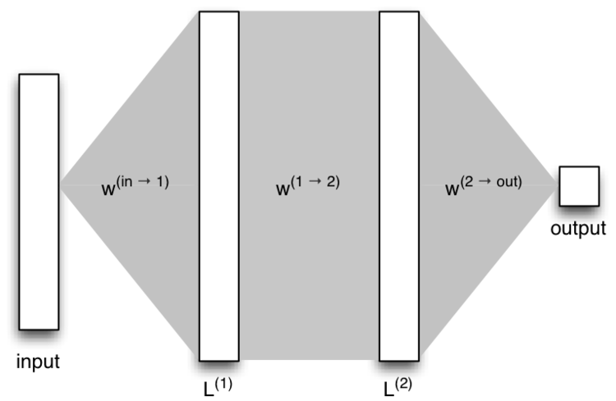

Slide 17
NumPy Basics

Slide 18
Create an Array/Matrix
import numpy as np
A = np.array([[1, 2, 3], [4, 5, 6]])
print(A.shape) # Output: (2, 3)

Slide 19
Slice a Matrix
A = np.array([[1, 2, 3], [4, 5, 6], [7, 8, 9]])
# START:STOP (slice does not include STOP)
A[1:, :]
# = np.array([[4, 5, 6], [7, 8, 9]])
A[1:] # equivalent
A[1:,2:] # = np.array([[6], [9]])

Slide 20
Advanced Slicing
A = np.array([[1, 2, 3], [4, 5, 6], [7, 8, 9]])
# replace START:STOP with a list of indices
A[[0, 2], 1:]
# = np.array([[2, 3], [8, 9]])
A[1:, [0, 2]]
# = np.array([[4, 6], [7, 9]])

Slide 21
Matrix Addition
A = np.array([[1, 2, 3], [4, 5, 6], [7, 8, 9]])
B = np.array([[3, 2, 1], [6, 5, 4], [9, 8, 7]])
C = A + B
# = [[ 4, 4, 4],
# [10, 10, 10],
# [16, 16, 16]]

Slide 22
Matrix Multiplication
A = np.array([[1, 2, 3], [4, 5, 6], [7, 8, 9]])
B = np.array([[3, 2, 1], [6, 5, 4], [9, 8, 7]])
C = np.matmul(A, B)
# = [[ 42 36 30]
# [ 96 81 66]
# [150 126 102]]

Slide 23
Do the NumPy/LinAlg Exercises
Complete the matrix exercises under “NumPy Warmup” and “Matrix Multiplication”

Slide 24
Basics of Neural Networks

Slide 25
Intro
We want to generate a prediction from some input
Output should give some probability of all our expected outputs
Network should give highest probability to correct class most of the time

Slide 26
Forward Pass

Slide 27
Fully-Connected Layers
Fully-connected layers are computations where every input element is connected to every output element
We transform the input by using weights to transform it into the output
The output will have a different shape than the input

Slide 28
Fully-Connected Network
Input
whiskers?
w₁
Output
w₅
w₂
# of legs
dog?
w₆
w₃
w₇
size
cat?
w₄
w₈
claws?

Slide 29
FC-Net as Matrix Mult
w₁ w₂ w₃ w₄
x
=
w₅ w₆ w₇ w₈

Slide 30
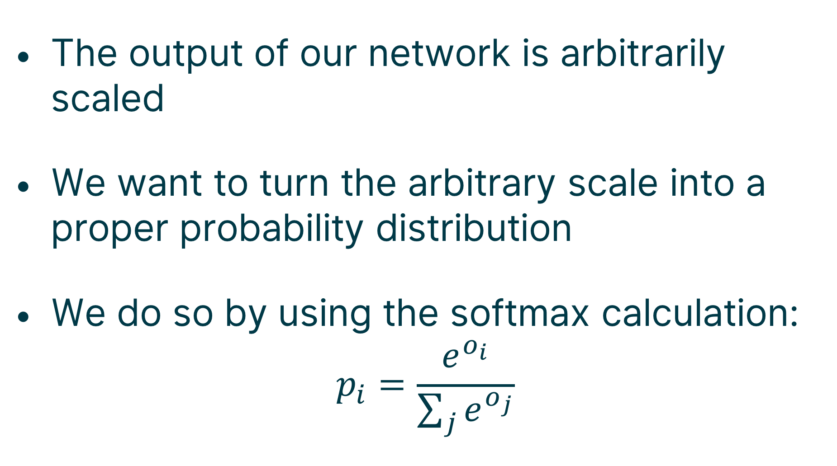
Probability Distribution
The output of our network is arbitrarily scaled
We want to turn the arbitrary scale into a proper probability distribution
We do so by using the softmax calculation:
$$p_{i}=\frac{e^{o_{i}}}{\sum_{j}{e^{o_{j}}}}$$

Slide 31



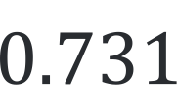
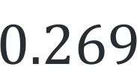

Softmax Layer
Output
Softmax
$$2$$
$$\frac{e^{2}}{e^{2}+e^{1}}$$
$$0.731$$
=
$$\frac{e^{1}}{e^{2}+e^{1}}$$
$$0.269$$
$$1$$

Slide 32
Code Up the Forward Pass
Split the dataset into train, validation, and test
Initialize the parameters to random
Create the linear and softmax layers

Slide 33
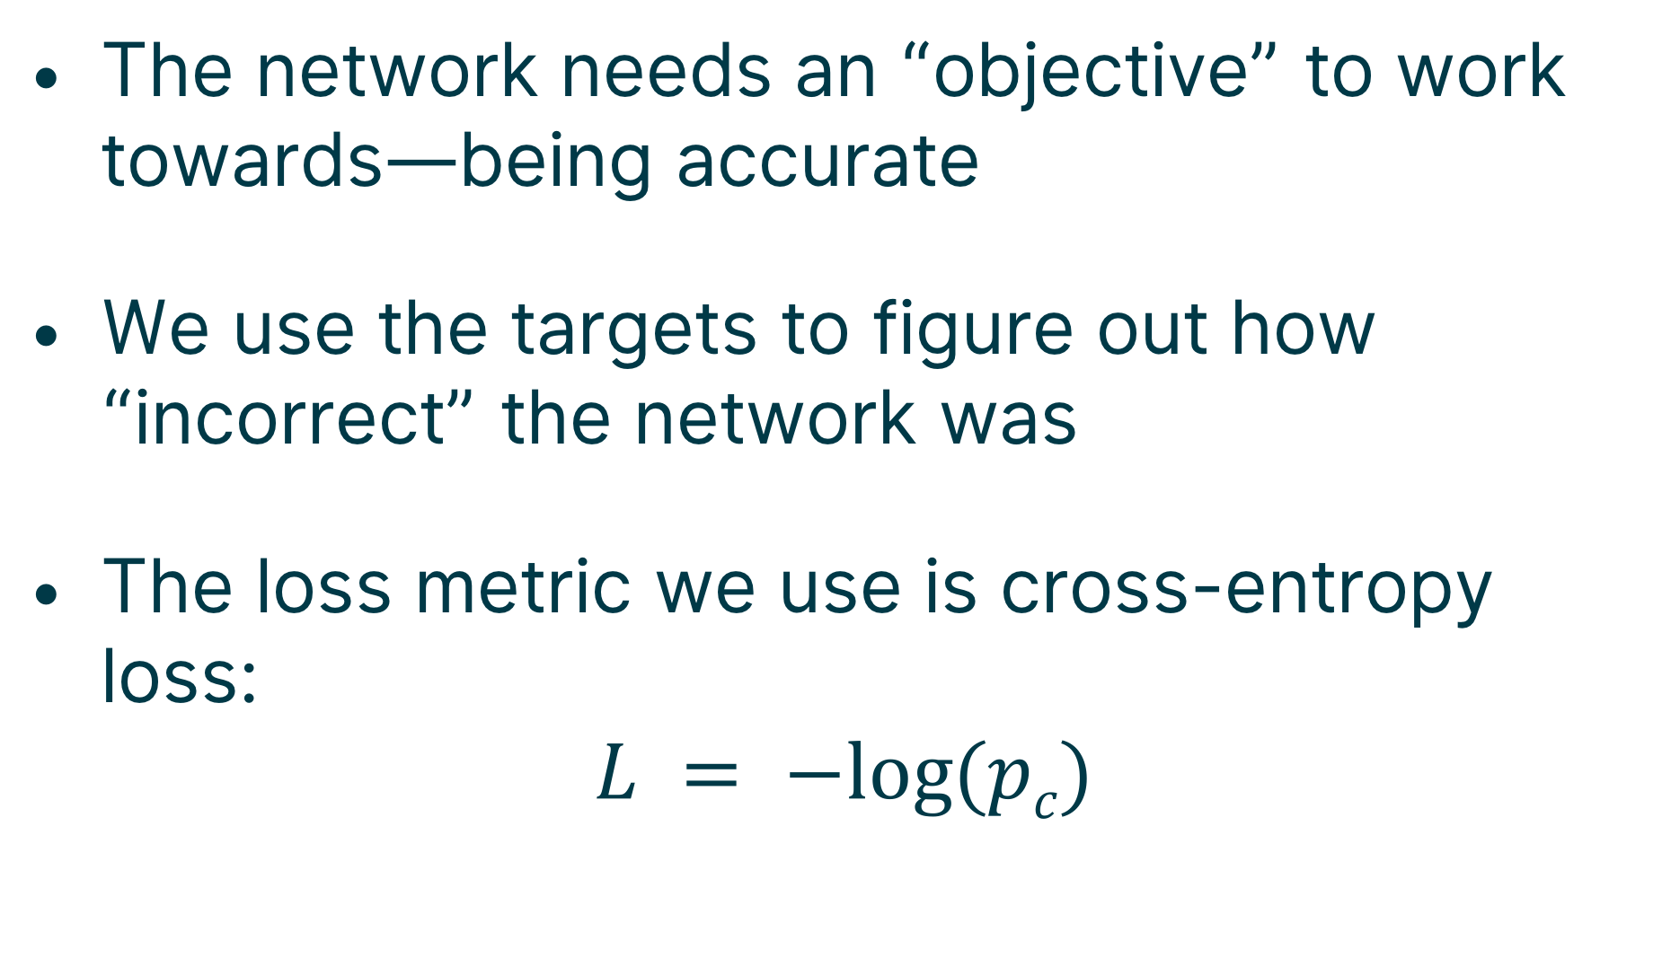
Loss Value
The network needs an “objective” to work towards—being accurate
We use the targets to figure out how “incorrect” the network was
The loss metric we use is cross-entropy loss:
$$L = −log⁡(pc)$$

Slide 34
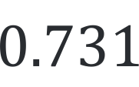
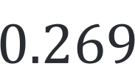
Cross-Entropy Layer
Softmax
Loss
$$0.731$$
L = -log(0.731) = 0.313
$$0.269$$

Slide 35
Data Splitting
We are interested in how our model does on unseen data above all
We can split data into training and test—but if we optimize on test, test becomes “indirectly” seen
Instead, we split into train, validation, and test; we run test only once

Slide 36
Code Up the Loss Calculation
Update the softmax cross-entropy layer to return the loss calculation

Slide 37
Backward Pass

Slide 38
Backpropagation
Each computation is represented as a node in a computational graph
Gradients are computed at each node of the graph
Chain rule is applied recursively to get total gradients on each weight

Slide 39
Simple Backprop
L = 3W² + 2
W
^2
6W
3
3
*
1
2
+
L
1

Slide 40
Multidimensional Backprop
L = sce(Wx + b)
W
x^{T}q
x
q
x
+
q_{j} = p_{j} – 1{j == c}
q
b
sce
L
1

Slide 41
Code Up the Backward Pass
Create the backward pass through the linear layer
Create the backward pass through the softmax cross-entropy layer

Slide 42
Training

Slide 43
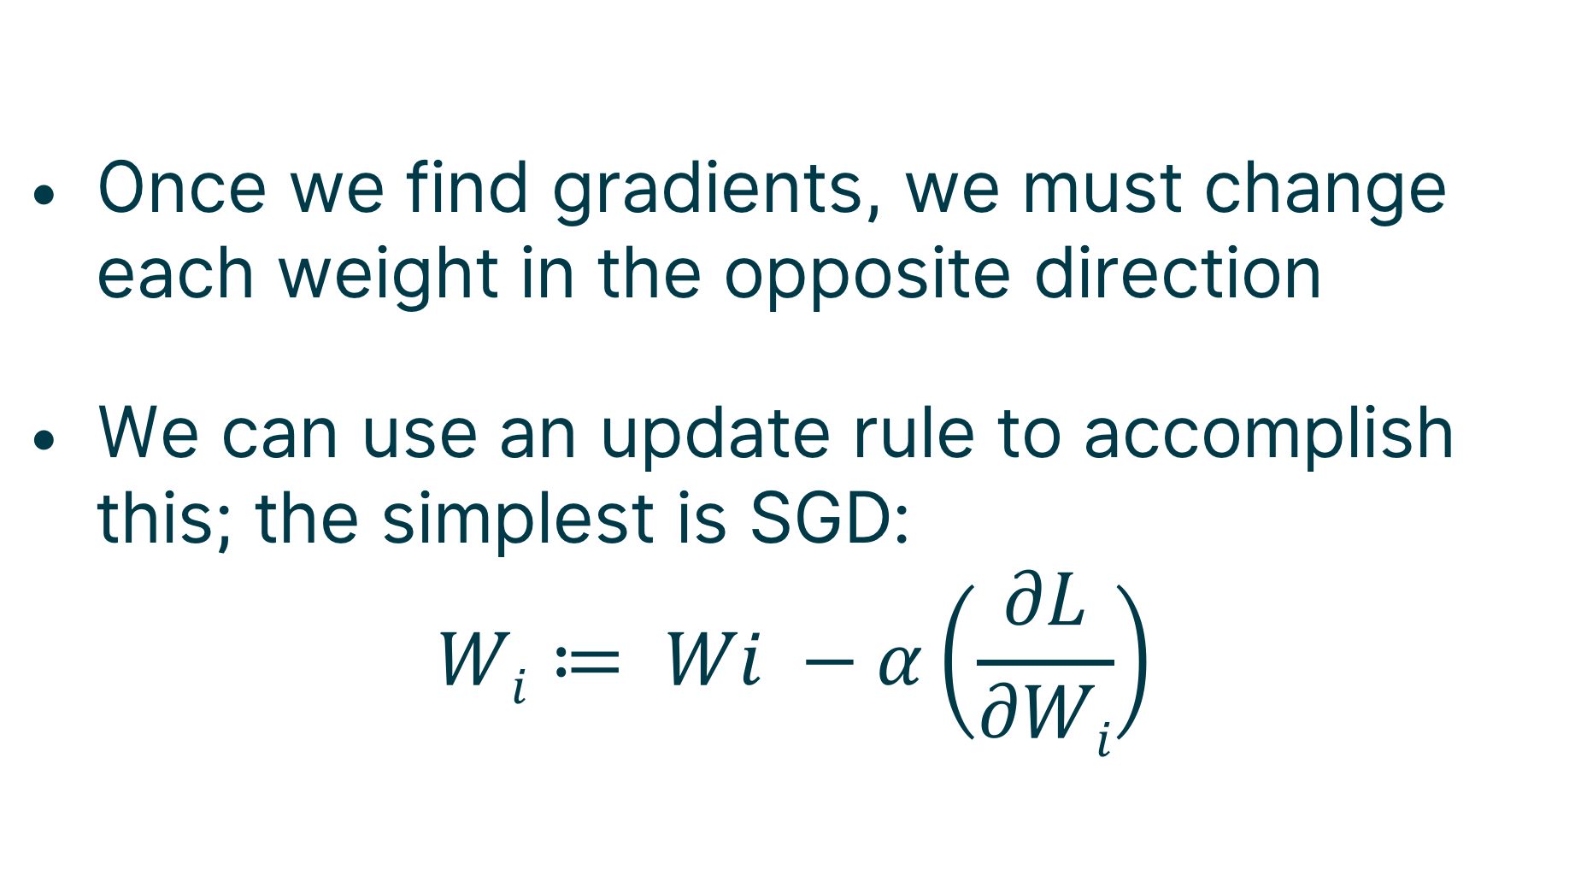
Weight Update
Once we find gradients, we must change each weight in the opposite direction
We can use an update rule to accomplish this; the simplest is SGD:
$$Wi≔ Wi −α\left(\frac{∂L}{∂Wi}\right)$$

Slide 44
Code Up the Training Regime
Code the training iteration loop
Implement SGD weight updates
Periodically log the training and validation losses

Slide 45
Predicting Breast Cancer Using NNs

Slide 46
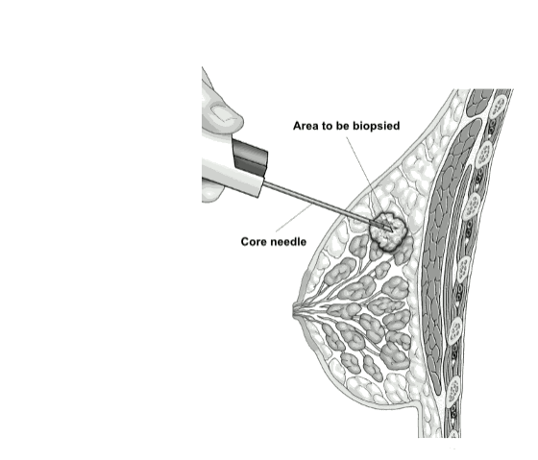

Slide 47
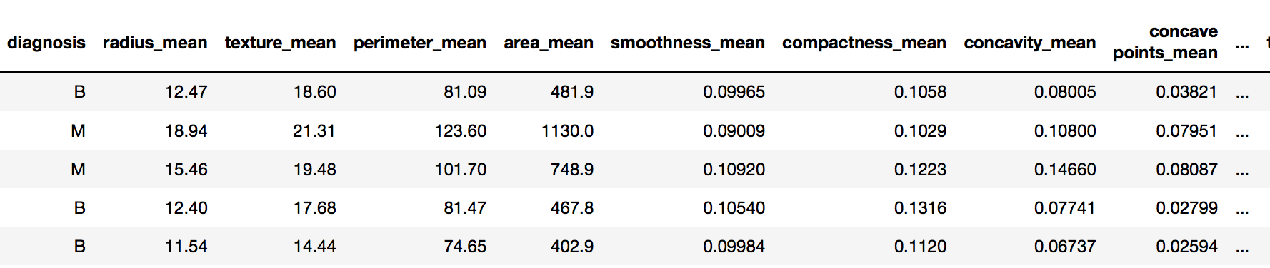
Data

Slide 48
NN We’ll Build
Input
radius
Output
texture
Neural
Network
malignant?
…
…
benign?
area

Slide 49
Using Keras for NNs

Slide 50
Keras API
from keras.models import Sequential model = Sequential()

Slide 51
Building a Model
model.add(Dense(2, activation='softmax', input_dim=4))
model.compile(loss='sparse_categorical_crossentropy', optimizer='sgd’, metrics=['accuracy'])

Slide 52
Building a Model
model.add(Dense(3, activation='relu', input_dim=4))
model.add(Dense(2, activation='softmax'))
model.compile(loss='sparse_categorical_crossentropy', optimizer='sgd', metrics=['accuracy'])

Slide 53
Training and Testing Model
model.fit(train['data'], train['labels'], epochs=num_epochs)
# test on validation set
model.evaluate(val['data'], val['labels'])

Slide 54
Train a Keras Model on Breast Cancer Data
Build and test your own 4-layer neural network under “Model Architecture and Training” in the Keras notebook

Slide 55
Being a Socially Responsible AI Engineer
Developing AI is an incredible power—use it for good!
Leverage public datasets and solve relevant problems
Make sure your data is representative of the real world

Slide 56
Next Steps
Check out public datasets on Kaggle
Look into teams at SAIL and around Stanford
Come to our workshop series next quarter!

